Slide 1

Synaptics Design Studio 6
Developed By Conan Tran

Slide 2
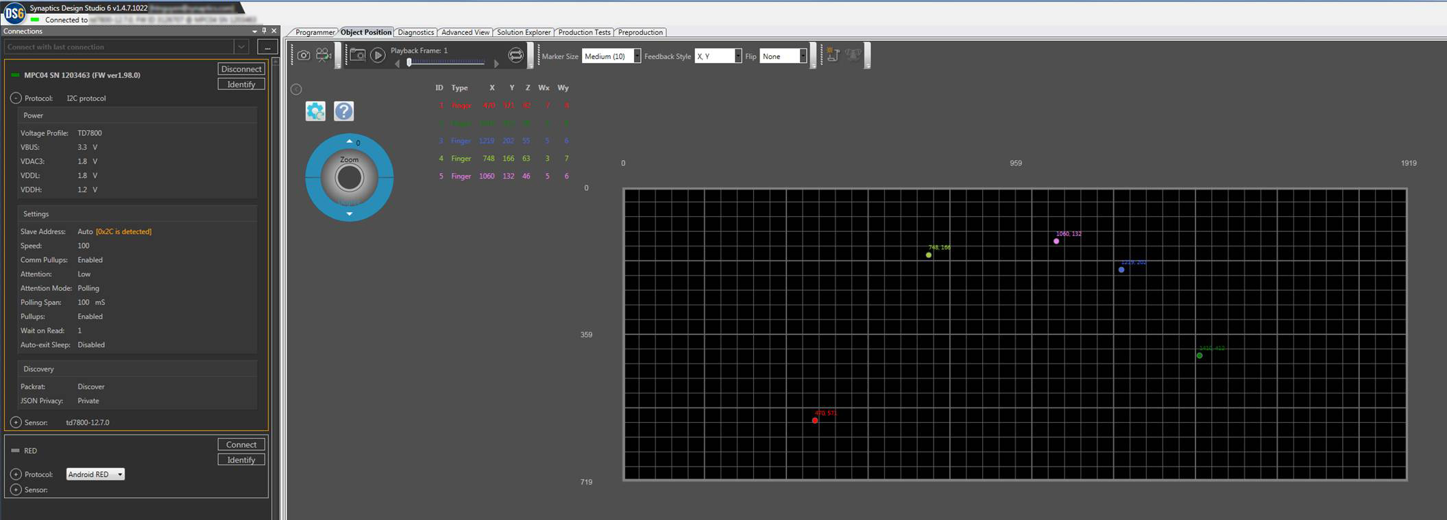
Display 2D Model in real time
Report conducted object position and object type in real time on a precise scale down canvas. Users also allow to
Zoom in/out Rotate the canvas Flip vertical/horizontal | Take snapshots Record & Playback User configurable settings

Slide 3
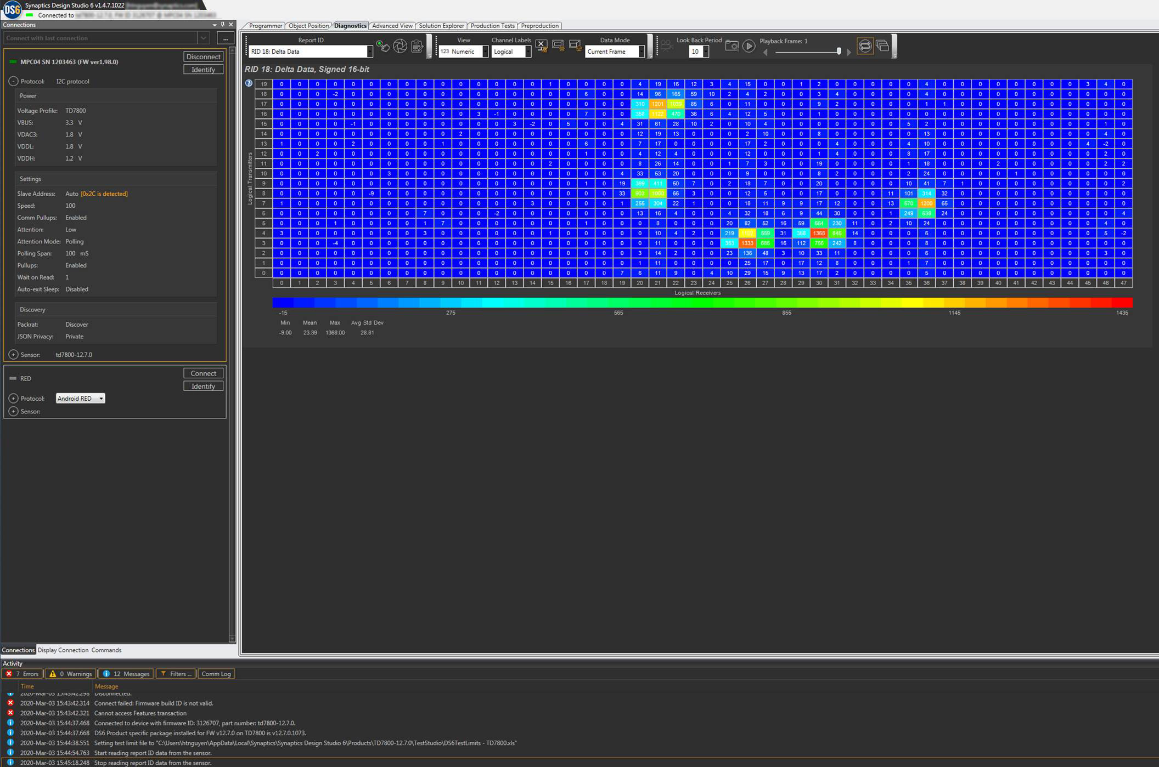
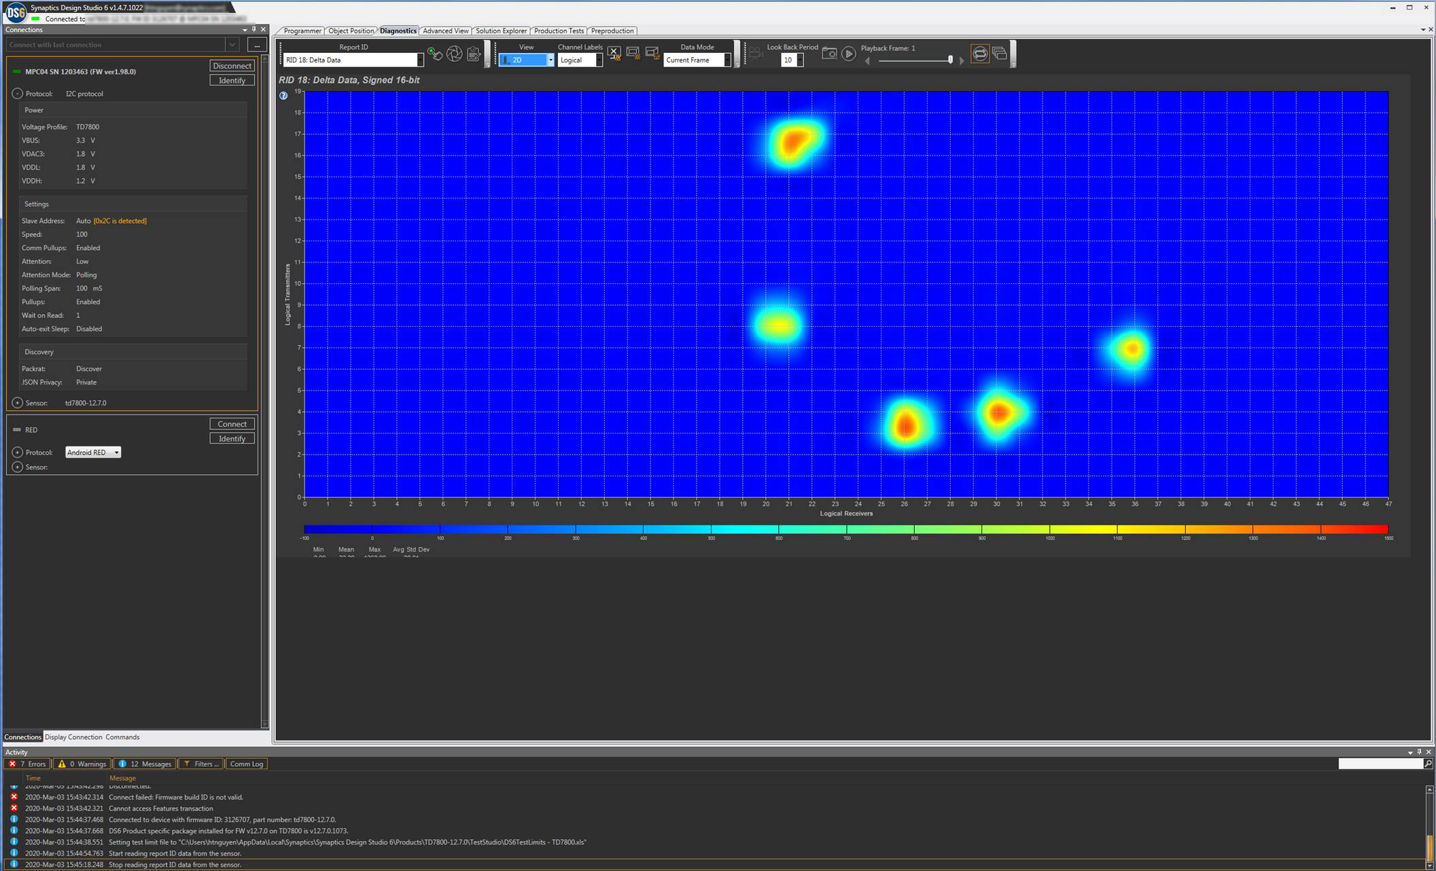
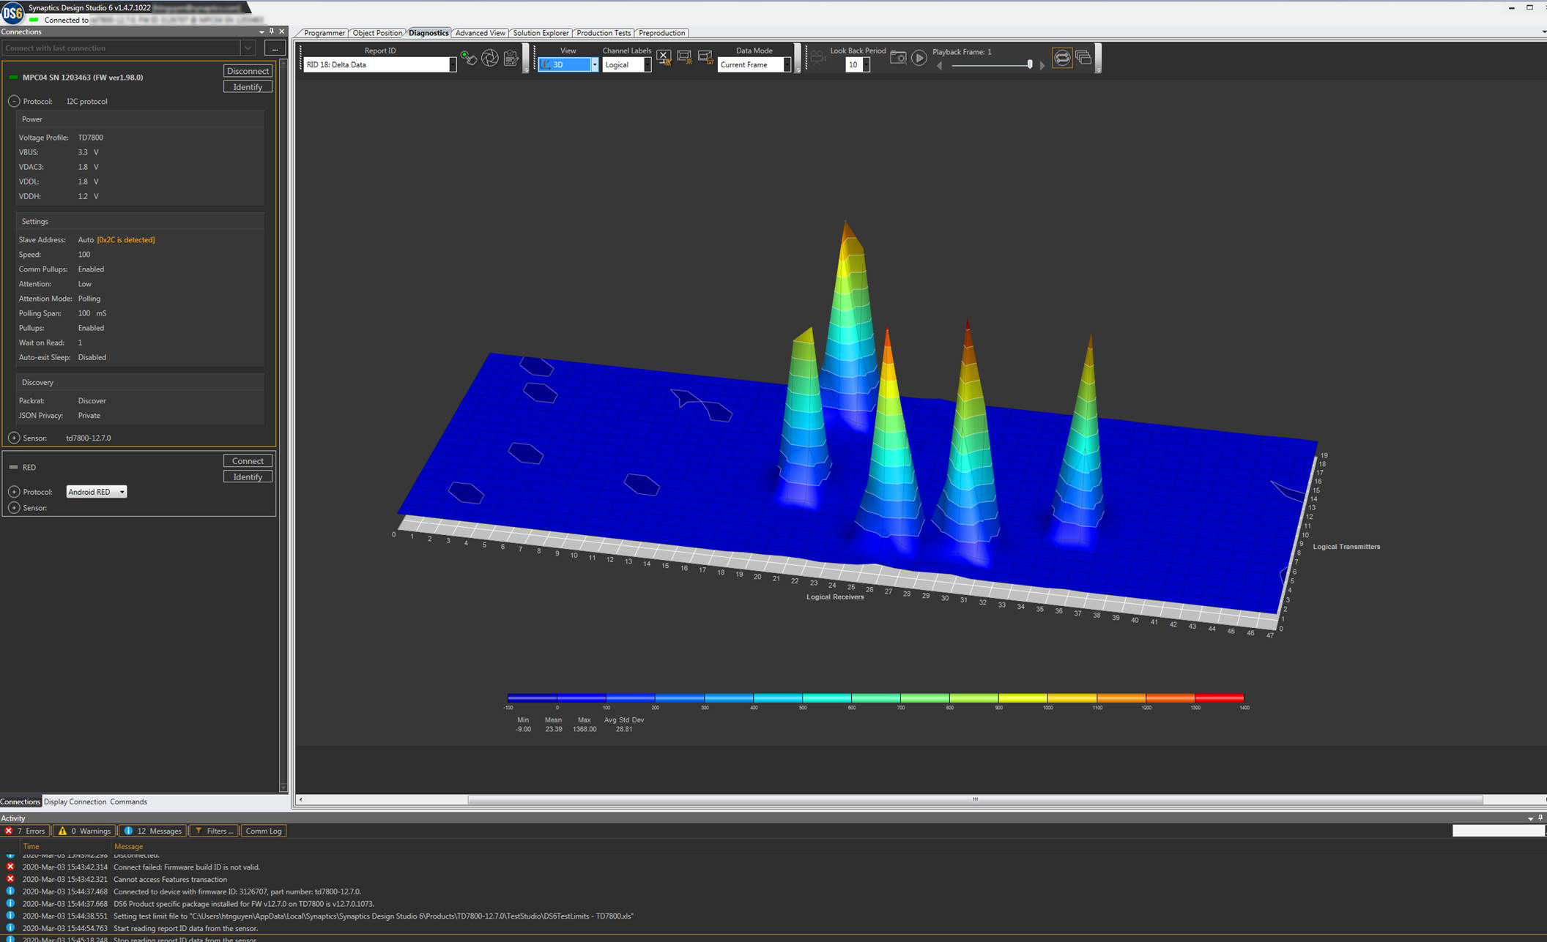
Diagnostic view with 2D & 3d model
1
[Left] Show conducted finger signals in numeric value for each pixel
2
[Right] Show conducted finger signals in the 3D Model (support rotate, move, and resize image)
3
[Above] Show conducted finger signals in 2D thermal style

Slide 4
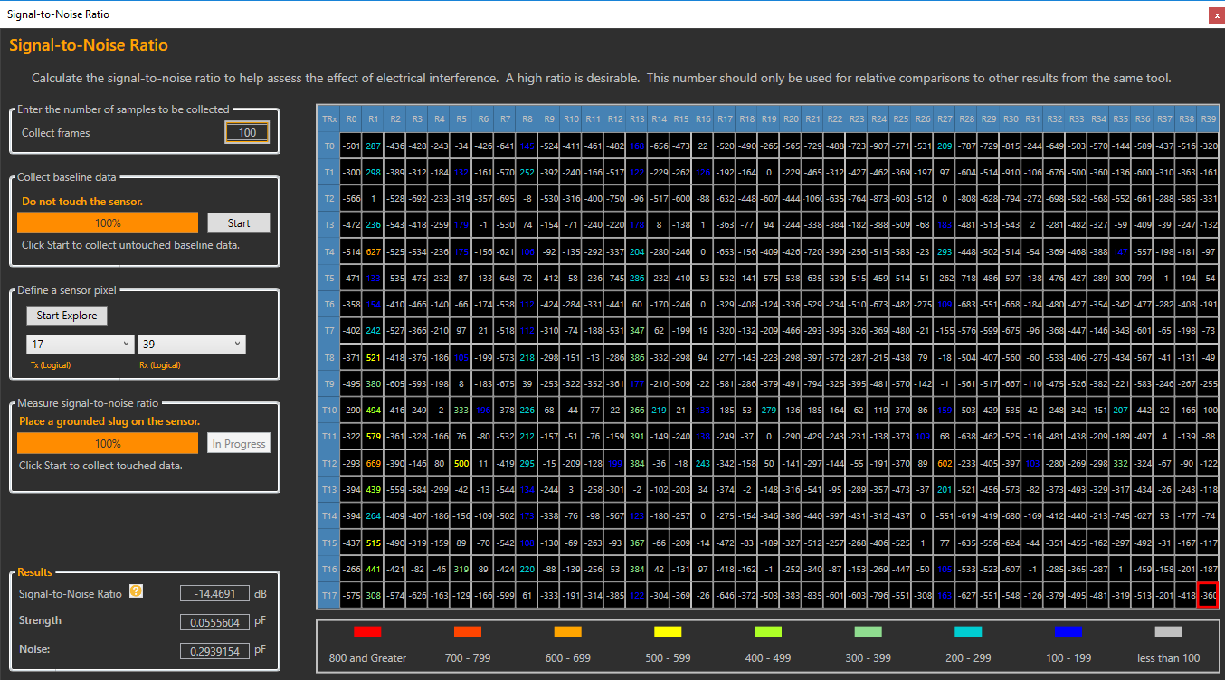
Signal & Noise ratio
Calculate the signal-to-noise ratio base on a user’s defined conducted area.

Slide 5
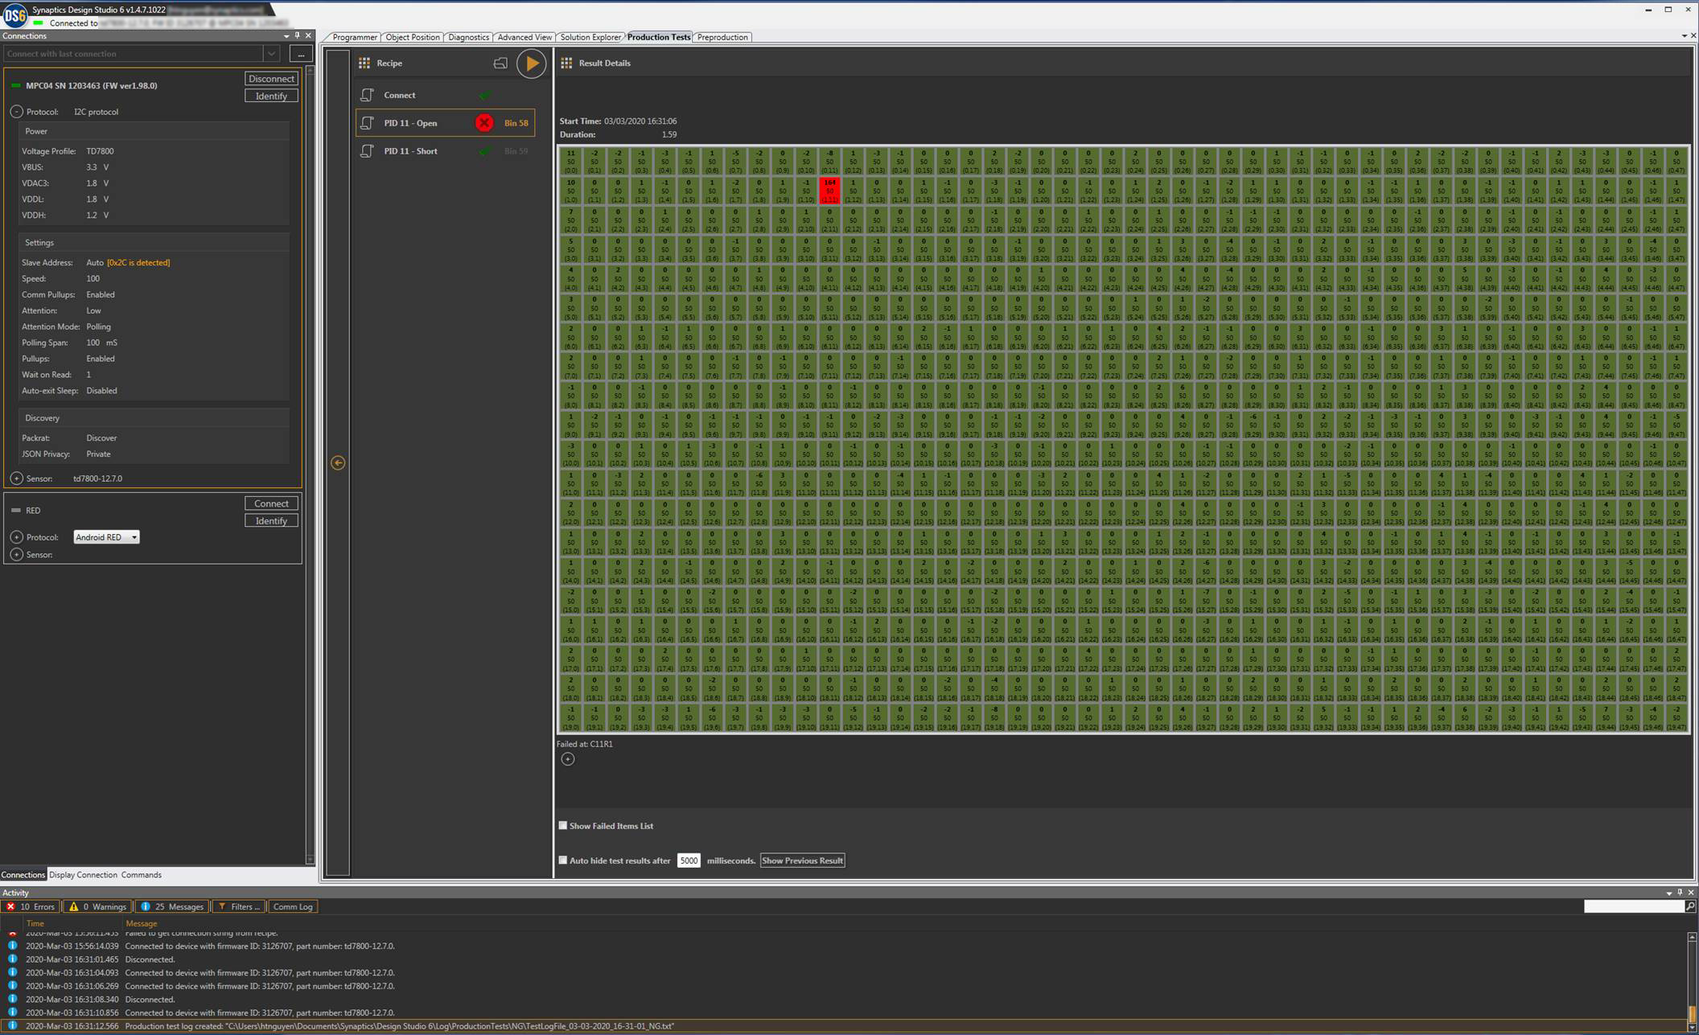
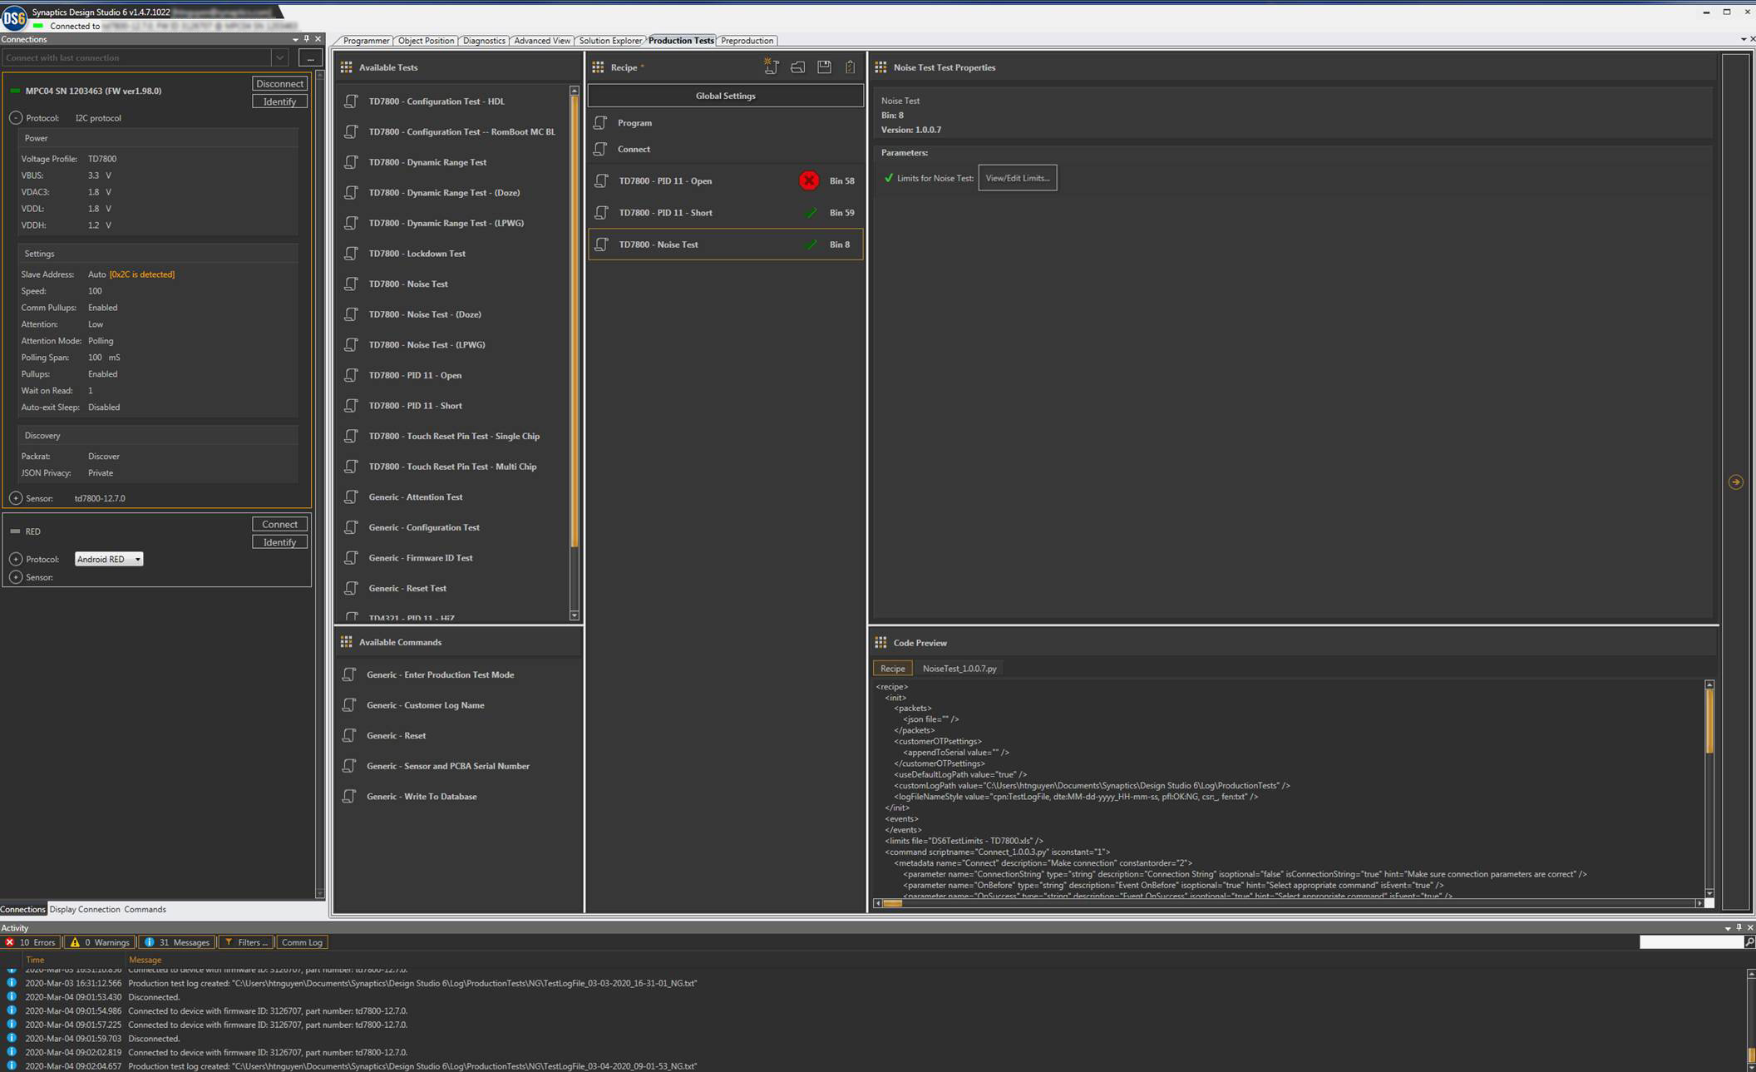
Production Test support
2
Production test result view that shows test limits and tested values as well as failed pixel(s).
1
Production Test Designer A centralize location that allow users to build a production test recipe using different test scripts. Users may also define new algorithm for their test need using Python scripts.

